Slide 1
Auto Sales Performance Dashboard
Data Analyst Internship - Task 3
By: Yashvithaa Rani Kumar

Slide 2
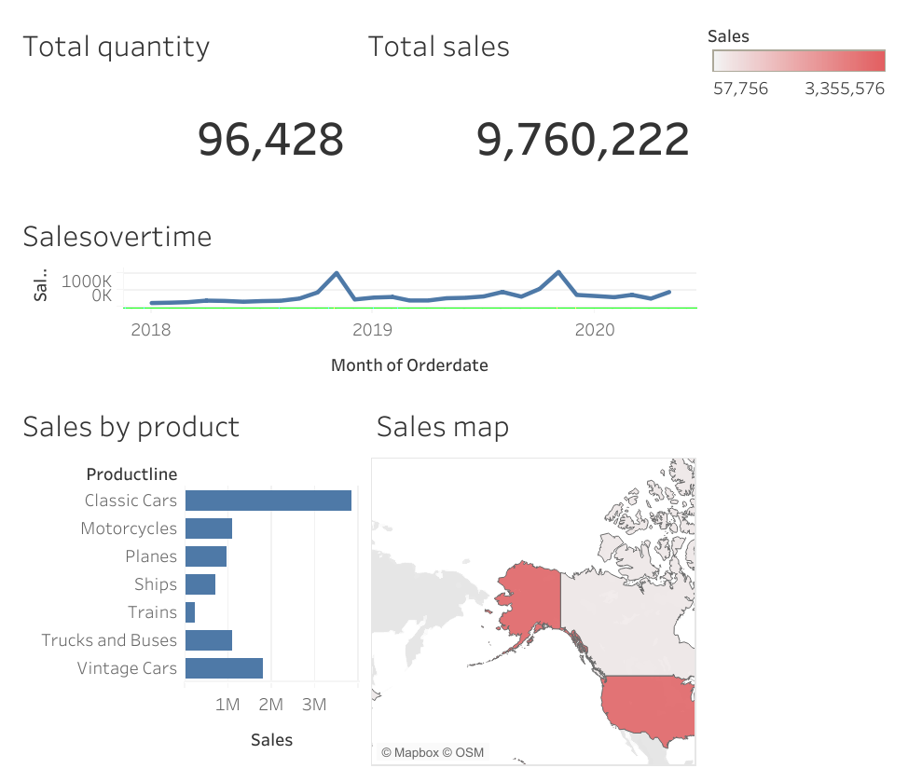
Dashboard Page

Slide 3
Key Insights from the Dashboard
KPIs at a Glance: The dashboard provides a high-level view of key metrics, tracking Total Sales and Total Quantity Ordered for the entire business.
Top-Performing Products: The "Sales by Product" chart clearly identifies 'Classic Cars' as the most profitable product line, driving the majority of sales.
Primary Market: The "Sales Map" highlights that the USA is the largest and most critical market by sales volume.
Sales Trends: The "Sales Over Time" chart shows the company's sales performance, revealing seasonal peaks and helping to identify the best-performing months.
Full Interactivity: The dashboard is fully interactive. Clicking a country on the map (like "USA") or a product in the bar chart filters all other charts to show specific insights for that selection.

